Slide 1
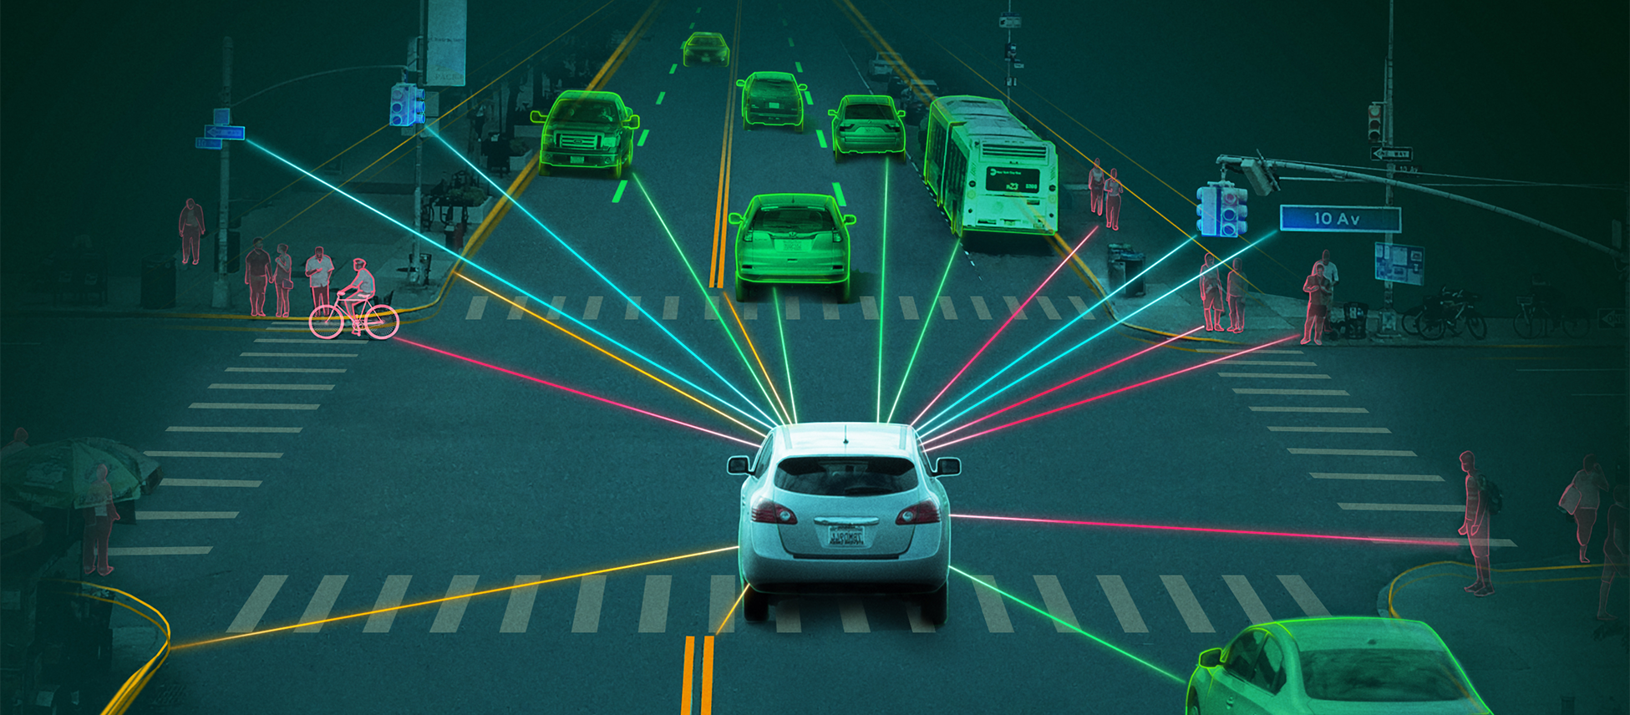
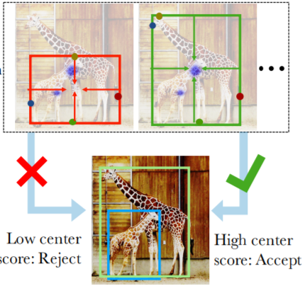
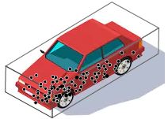
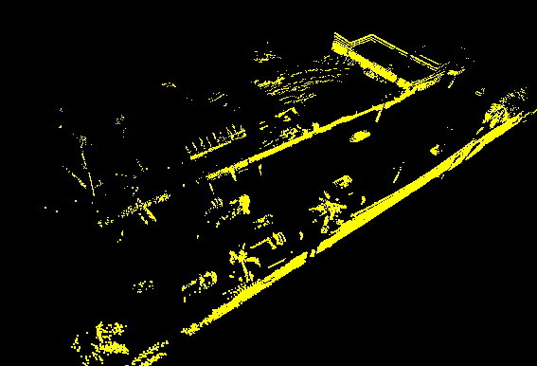
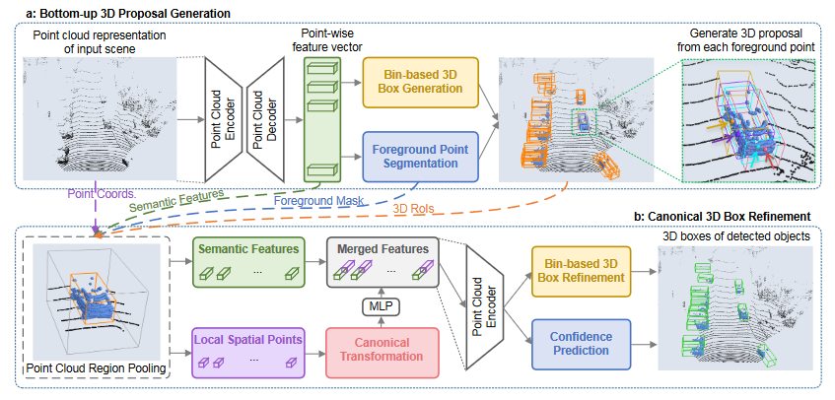
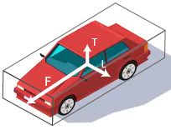
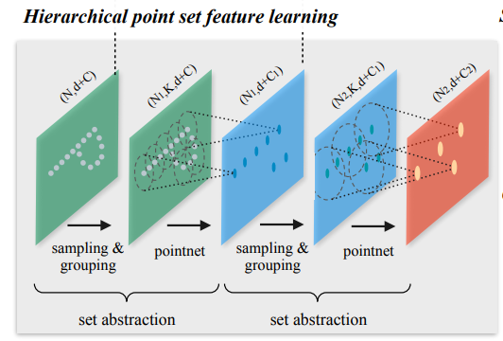
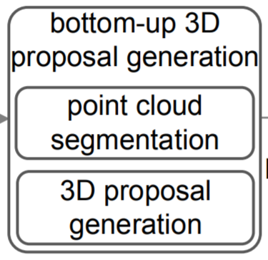
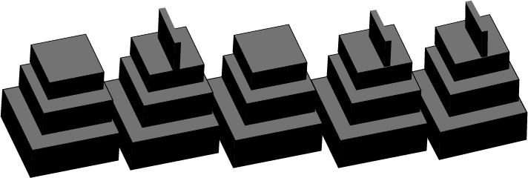
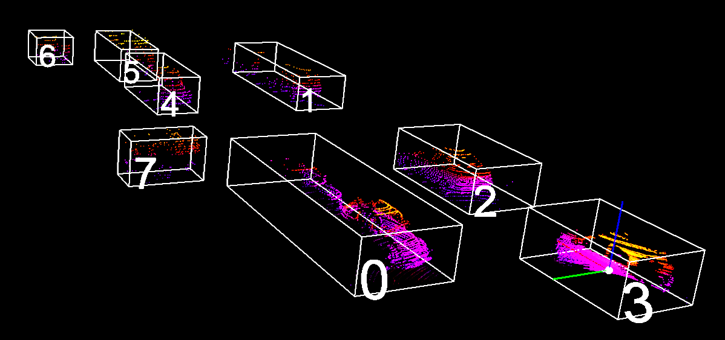
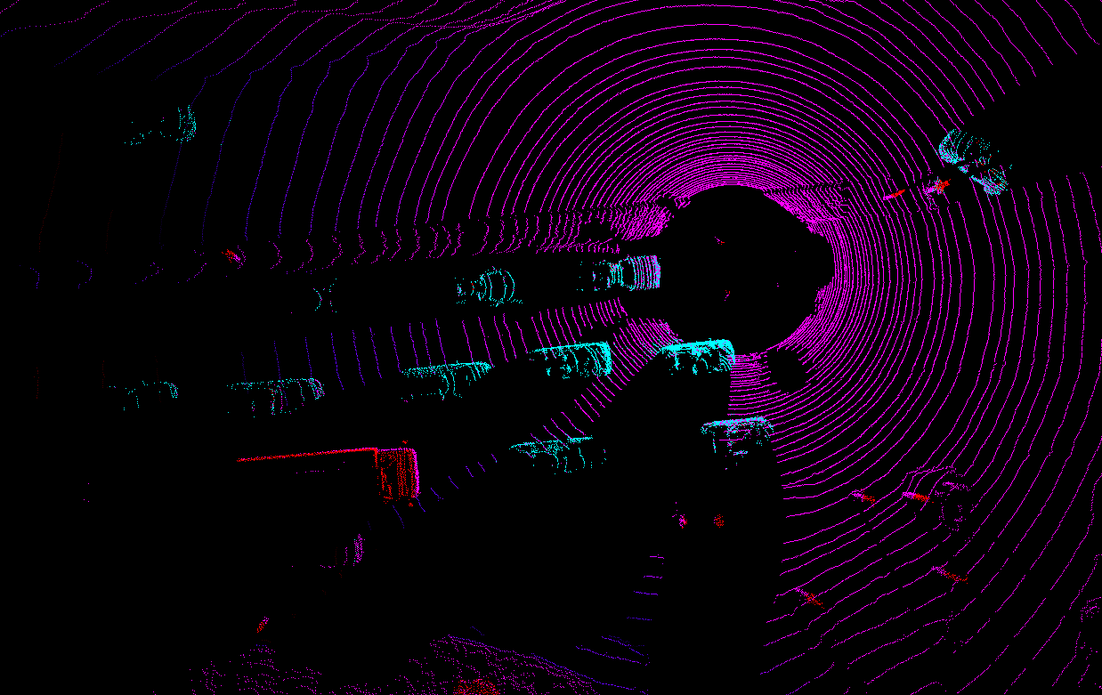
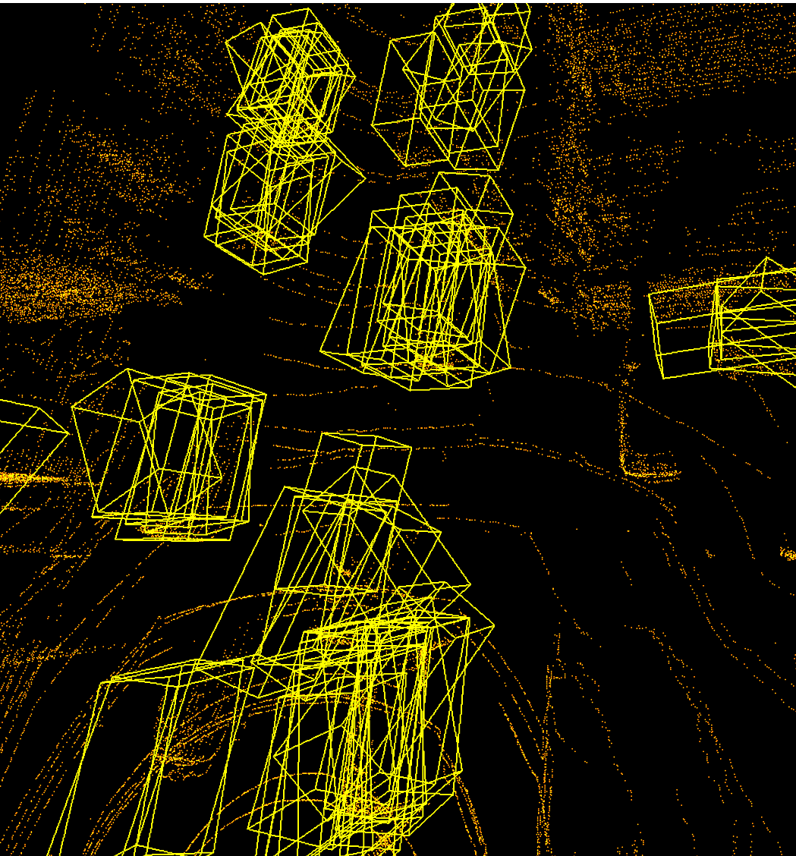
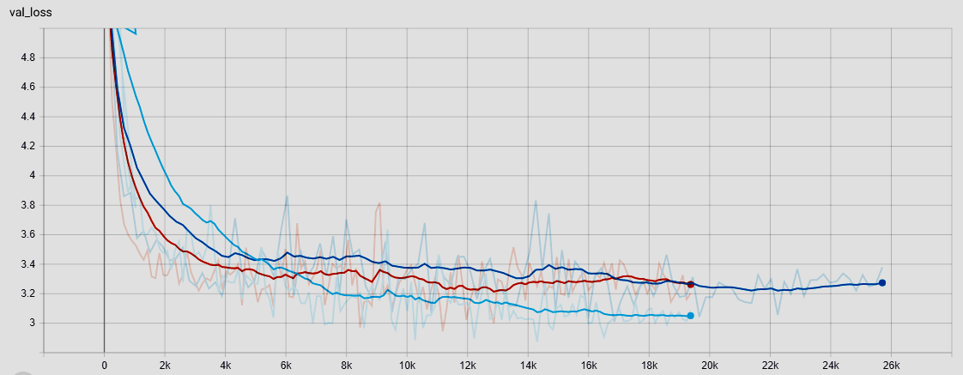
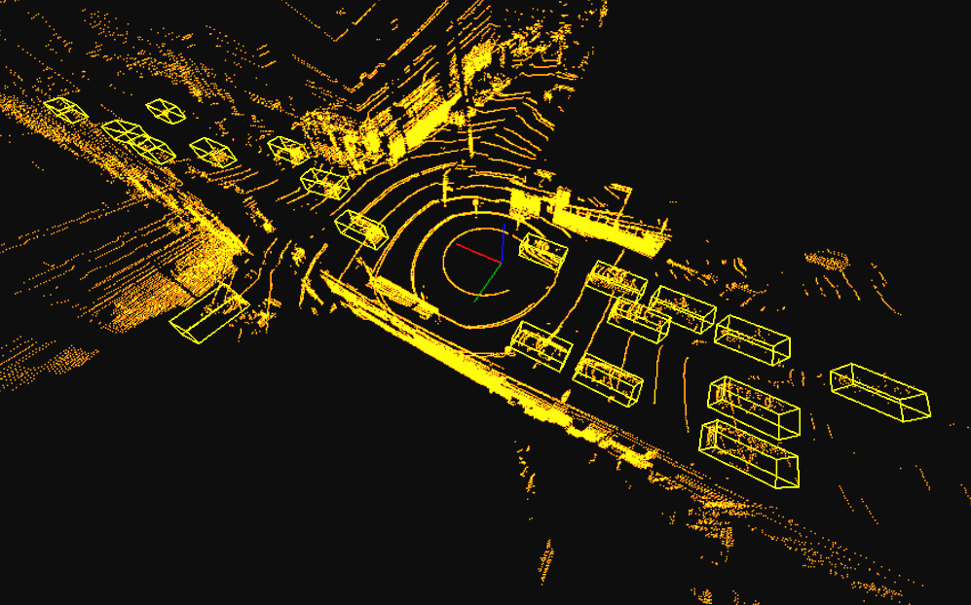
Centerness of Bounding box detections in LiDAR Pointclouds
Chuhan Feng, Manoj M Bhat, Sweta Priyadarshi
Carnegie Mellon University
INTRODUCTION
RELATED WORK
DATASETS
An Autonomous vehicle is dependent on the perception system for understanding the surrounding while taking decisions and actions in the environment. But deploying these algorithm poses high-risk challenges in detection.
With the availability of deep learning models, accuracy of 2D detection has been on rise, but not so for 3D.
Many AV companies propose using LiDAR sensors which provide rich Pointclouds of ego vehicle surrounding environment.
We explore and propose solutions to Object Detection (3D-OD) by just using LiDAR Pointclouds as inputs.
Many deep learning architecture work veyr well for 2D detection tasks i.e Given an image, finding a bounding box which defined as
axis aligned corner points in cartesian coordinates . Whereas for bounding boxes, state of the art [4] approach use 6 element definition
representing center, shape and yaw of box.
Some appraoches like PointPillars [1] directly regress these bounding box definition by parsing pointclouds
Argoverse V1.1
Lyft Level 5
3D tracking annotations for 113 scenes
113 log segments with 15-30 seconds for each segment
Point clouds with 107000 points at 10Hz
11052 total tracked objects
17 classes of object labels
Total size of 266 GB
25-45 seconds for each log segment
Point clouds with 216000 points at 10Hz
19 classes of object labels
Total size of 80 GB
Many object detection methodologies in 2D [3,5] suggest approximating the Aspect ratios of bounding boxes rather than predicting the corners. We inspire from this idea and extend to 3D detection.
Towering approach was introduced by [5]. This approach suggests individual feature regression. We implement similar idea.
Data Preprocessing
Ground Removal by Plane Fitting (PCA)
Drivale area points removal
Random sampling of 48600 points as input to RPN stage
Cropped Point-Cloud to an area of +60m from all four sides.
Training for Pedestrain detection on only Non-drivable area point-cloud.
METHODOLOGY
Baseline 1: PIXOR
Baseline 2: PointPillars
Baseline 3: PointRCNN
Direct manipulation of 3D point clouds suffers from slow computational speed
Project 3D point clouds onto 2D Bird’s Eye View (BEV) images, which simplifies the original 3D detection problem into 2D detection
2D Convolutional Neural Network (CNN) is used as the backbone of the detection pipeline
Single Stage Detection (SSD) header is used to classify foreground points and regress the position of bounding boxes
Similar to PIXOR, PointPillars also reduce the dimension of the problem from 3D to 2D
Instead of directly projection, PointPillars extract hand-crafted features from vertical pillars, then uses a MLP to learn an abstraction from it
2D CNN backbone is used with 2D pseudo images as input
Single Stage Detection (SSD) header is employed
Directly process 3D point clouds with PointNet
PointNet architecture consist of sampling layers, grouping layers, and PointNet layer
Analogous to CNN, PointNet does calculations on each local group in 3D point clouds and then downsample the point clouds
Two-stage bounding box proposal detection and refinement
PROPOSED METHOD
ARCHITECTURE DETAILS
We introduced the concept of centerness in PointRCNN framework to amplify the effect of depth in the detection model as shown below:
This modified the loss function as below:
Loss function= 1/N(classification loss + regression loss + centerness loss + angular loss)
The other losses remain the same as mentioned in PointRCNN paper but the centerness loss is the L2 norm of predicted centerness with target centerness.
ENCODER
DECODER
Classification Loss:
Angular Loss:
Overall Loss Function:
PointNet ++ Point Cloud aggregation
Point-wise Feature Vector
Proposal Generation
Refinement By Convolutional Towers
Regression Loss:
Centerness Loss:
NMS
Non Maximum Suppression
RESULTS
CONCLUSION
`
After doing some experiments, it was found that Centerness architecture with centerness loss gave better Precision and MIoU compared to PointRCNN. Although the Recall is less than the latter.This will be due to the NMS thresholding stage.
Our architecture reaches SOTA results.
Implementing centerness loss for Bounding box refinement largely reduced the total loss while training and Validation
Implementing Dropouts (p = 0.7) at the last layers let to much faster refinement results.
The results obtained by center predictions reach SOTA by augmenting the Loss function parameters by an extent of about 1.2x.
Training on Argoverse Tracking dataset gives better performance than training on Lyft dataset. Larger dataset overfits the Segmentation model but generalizes Object detection head performance.
Fig: BEV of Segmentation results
REFERENCES
[1] PointPillars: Fast Encoders for Object Detection from Point Clouds, “Alex H. Lang and Sourabh Vora and Holger Caesar and Lubing Zhou and Jiong Yang and Oscar Beijbom”, publication at CVPR 2019
[2]PIXOR: Real-time 3D Object Detection from Point Clouds, “Bin Yang, Wenjie Luo, Raquel Urtasun Uber Advanced Technologies Group University of Toronto”, publication at CVPR 2019
[3]FCOS: Fully Convolutional One-Stage Object Detection, “Zhi Tian and Chunhua Shen and Hao Chen and Tong He”, CVPR ArXiV 2019
[4]PointRCNN: 3D Object Proposal Generation and Detection from Point Cloud, “Shaoshuai Shi Xiaogang Wang Hongsheng Li The Chinese University of Hong Kong”, Accepted by CVPR 2019
[5]Bottom-up Object Detection by Grouping Extreme and Center Points,” Xingyi Zhou and Jiacheng Zhuo and Philipp Krähenbühl”, CVPR 2019
Fig: Validarion loss comparision with and without dropout
Validation of Model on KITTI | AP (IoU=0.7) - Car Class |  |  | Average Recall (IoU=0.7)
 | Easy | Moderate | Hard
Pixor | 87.68 | 60.05 | 21.62 | 50.45
PointRCNN | 85.94 | 75.76 | 68.32 | 82.29
PointRCNN + Centerness | 87.24 | 78.92 | 75.33 | 73.68
Fig: Detection results (Green- GT, Yellow-Predicted)
Table: Validation results on KITTI and Argo
ACKNOWLEDGEMENT : This project is done as a part of course curriculum of Introduction to deep learning 11785

Slide 2
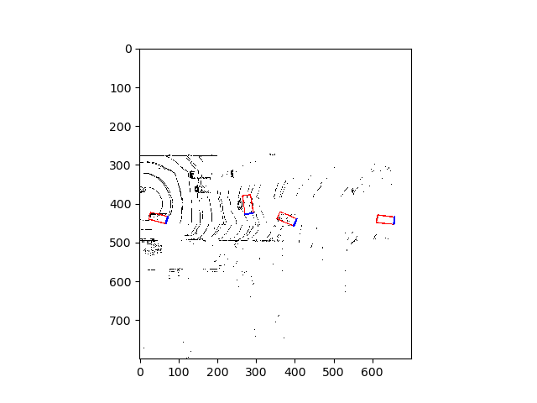
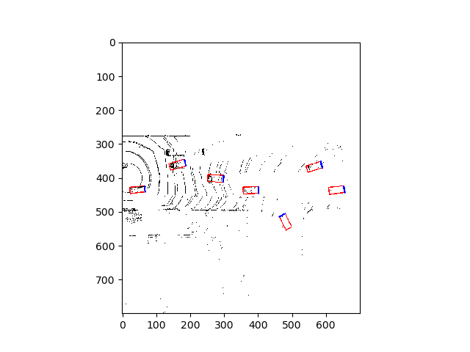
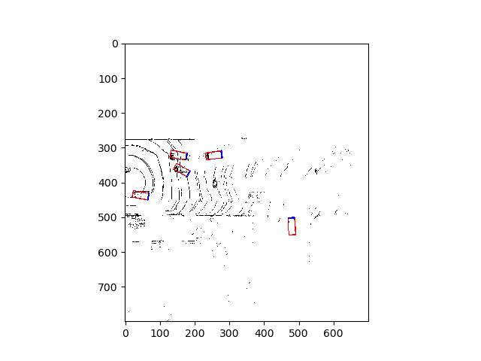
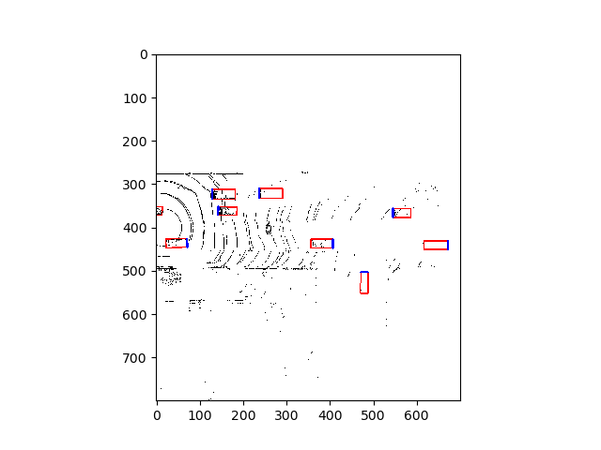
PIXOR experiment results
epoch 3
epoch 5
epoch 7
ground truth

